Slide 1
Object Oriented Programming with C++
Object oriented programming
Spring 2024
Lecture - 13

Slide 2
Types of Constructors
Default constructor
Parameterized Constructor
Copy Constructor

Slide 3
Default constructor
It does not have any parameters
If no user defined constructor exists for a class, C++ compiler generates a default constructor
Example:
class Rectangle
{
int length;
int width;
public:
Rectangle(); //default made by user
…}
Rectangle::Rectangle()
{
length=1;
width=1;
}
void main()
{
Rectangle R1;
R1.printValues();
}

Slide 4
2. Parameterized Constructor
It is a constructor with some parameters
There may be more than one implementation of parameterized constructors
Example:
class Rectangle
{
int length;
int width;
public:
Rectangle(int,int);
…}
Rectangle::Rectangle(int a, int b)
{length=a; width=b;}
void main()
{
Rectangle R1(1,2);
R1.printValues();
}

Slide 5
2. Parameterized Constructor (contd.)
Example:
class Rectangle
{
int length;
int width;
public:
Rectangle(int,int);
Rectangle(int);
…}
Rectangle::Rectangle(int a, int b)
{length=a; width=b;}
Rectangle::Rectangle(int a)
{length=a; width=0;}
void main()
{
Rectangle R1(1,2);
R1.printValues();
Rectangle R2(3);
R2.printValues();
}

Slide 6
Constructor with default parameters
A sub category of Parameterized constructor is “Constructor with default parameters”
Example:
class Rectangle
{
int length;
int width;
public:
Rectangle(int =0 ,int =0);
…}
Rectangle::Rectangle(int a, int b)
{length=a; width=b;}
R1.length=0
R1.width=0
R2.length=1
R2.width=2
void main()
{
Rectangle R1;
Rectangle R2(1,2);
}
No need of writing a default constructor separately.
When an object is created without any parameters, default values are set to data members

Slide 7
What is output?
void main()
{
Rectangle R1(1,2);
R1.printValues();
Rectangle R2(3);
R2.printValues();
Rectangle R3;
R3.printValues();
}
class Rectangle
{int length;
int width;
public:
Rectangle(int =1,int=1);
Rectangle(int);
…}
Rectangle::Rectangle(int a, int b)
{length=a; width=b;}
Rectangle::Rectangle(int a)
{length=a; width=0;}

Slide 8
What is output?
void main()
{
Rectangle R1(1,2);
R1.printValues();
Rectangle R3;
}
class Rectangle
{int length;
int width;
public:
Rectangle(int, int);
…}
Rectangle::Rectangle(int a, int b)
{length=a; width=b;}
At this point, Compiler will generate an error that no default constructor is found.
If any constructor is provided, compiler will not generate the default constructor itself

Slide 9
3. Copy Constructor
This copies the data of another object at the time of creation
Example:
class Rectangle
{int length;
int width;
public:
Rectangle(Rectangle);
…}
Rectangle::Rectangle(Rectangle a)
{length=a.length;
width=a.width;}
void main()
{
Rectangle R1(1,2);
Rectangle R2(R1);
}
//R2 is copy of R1

Slide 10
3. Copy Constructor (contd.)
Example: A better implementation
class Rectangle
{int length;
int width;
public:
Rectangle(const Rectangle &);
…}
Rectangle::Rectangle(const Rectangle &a)
{length=a.length;
width=a.width;}
void main()
{
Rectangle R1(1,2);
Rectangle R2(R1);
}
//R2 is copy of R1

Slide 11
Assignment Operator
We can do this:
Rectangle R1(2,3);
Rectangle R2;
R2=R1;
Assignment operator works for all objects and do member wise assignment.

Slide 12
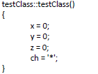
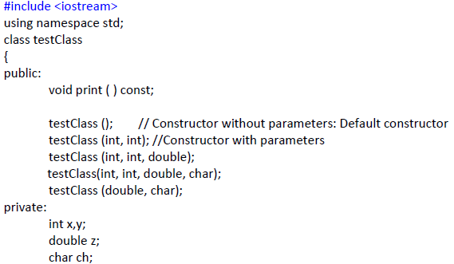
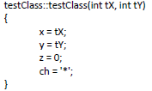
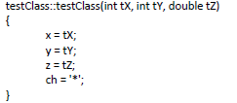
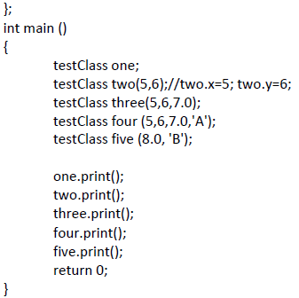

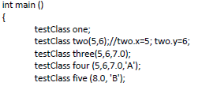
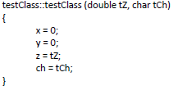
Example

Slide 13
exercises

Slide 14
Exercise - 1
class Demo{
int x;
double y;
char temp;
public:
Demo(int, double, char);
void PrintValues() const;
bool CompareObjects(const Demo &); //if both objects have same values return true else //return false
};
void main()
{
Demo A(2,3,‘F’);
A.PrintValues();
Demo B();
B.PrintValues();
//Convert the following pseudo code into C++
//If A and B are exactly same then
//Display “both are same”; otherwise display “both are different”;
}
//write implementation of all member functions of class Demo

Slide 15
Exercise - 2
Consider the following class:
class Student
{
private:
int Id;
char Name[100];
public:
….
};
Write constructor with parameters for this class
Can you implement a constructor with default parameters for this class?
Implement a default constructor for this class

Slide 16
Exercise – 3
Create a class for complex numbers. Implement following functions:
Constructor with default parameters
Copy Constructor
A function to add two complex numbers and returns the result in form of another complex number
Sample MAIN:
void main()
{complex A(2.4, 1.2), B,C;
C=A.add(B);}

